Slide 1

IoT Real World Programmable Blocks
SUPERVISOR
Md. Shahiduzzaman
Assistant Professor
Dept. of CSE
Dhaka City College
SUBMITTED BY
Md. Antor Ahmed
Reg. No: 16502000527
Al Sabid
Reg. No: 16502000525
Session: 2016-17

Slide 2
Presentation Outline
2
Introduction
Existing System
Drawbacks of Existing System
Proposed System
Why it is preferable?
Applications of IoT Blocks
H/W & S/W Requirements
Methodology
Block Diagram
Circuit Design
E-R Diagram
PCB Design
Implementation
Simple Script
Application
Future Work
Conclusion
IOT REAL WORLD PROGRAMMBLE BLOCKS

Slide 3
Introduction
3
Building an IoT gadget requires a ton of knowledge, but with IoT Blocks there is no need for expertise in circuits or network programming. With an IoT block in every project, home, office we can add smart features like motion-sensitivity, remote control, orientation monitoring, voice commands, notifications, text messaging, and more.
IOT REAL WORLD PROGRAMMBLE BLOCKS

Slide 4
Existing System
4
IoT Smart Home
IoT in Agriculture Monitoring
Google Home Voice Controller
Amazon Dash Button
Smart door Lock
Air Quality Monitor
IOT REAL WORLD PROGRAMMBLE BLOCKS

Slide 5
Drawbacks of Existing System
5
The major problem of IoT devices they are totally independent, that’s mean each device do a specific predefined task always.
Less configurable options.
For multiple tasks, need multiple apps.
Customization in device function aren’t allowed.
IOT REAL WORLD PROGRAMMBLE BLOCKS

Slide 6
Proposed System – 1/3
6
Developing few tiny portable blocks that are directly connected to the server and can use them from a central computer by programming for any kind of logical expression.
IOT REAL WORLD PROGRAMMBLE BLOCKS

Slide 7
Proposed System – 2/3
7
IoT Blocks are consist of five sections:
Input device blocks (Buttons, Temperature, Motion etc.).
Output device blocks (LED, Buzzer etc.).
Python Module.
Server-side API.
Database.
IOT REAL WORLD PROGRAMMBLE BLOCKS

Slide 8
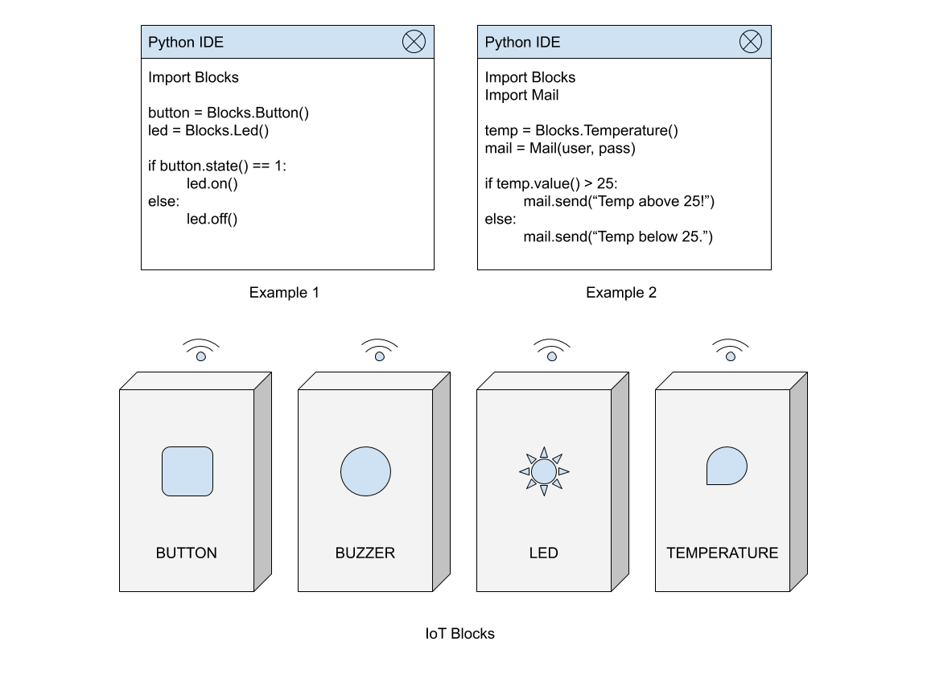
Proposed System – 3/3
8
IOT REAL WORLD PROGRAMMBLE BLOCKS

Slide 9
Why it is preferable – 1/2
9
Easily can integrate to any environment.
Can apply any logical expression, iteration.
Blocks can be used as single or combined together.
Can be re-programmed on demand.
Its Increases productivity of our daily life.
Teaching programming logics easily to high school students.
IOT REAL WORLD PROGRAMMBLE BLOCKS

Slide 10
Why it is preferable – 2/2
10
Simplify large tasks into smaller.
This is very useful for security system in home and office.
Replacement for current smart home automation devices.
No limitation of use.
IOT REAL WORLD PROGRAMMBLE BLOCKS

Slide 11
Some Applications of Programmable IoT Blocks:
11
Automation of Train Crossing
Automation of Traffic signals
Home Automation
Factory/Office Automation

Slide 12
H/W & S/W Requirements
12
Hardware
ESP8266
Button
Resistors
AMS1117
Buzzer
DHT11
LED
Software
Arduino IDE
C++, Python
PHP
MySQL
Fusion 360
Proteus 8
VS Code
IOT REAL WORLD PROGRAMMBLE BLOCKS

Slide 13
Methodology
13
We use MySQL as a database.
Programming languages like C++, Python, PHP are used generally.
Arduino IDE for hardware level programming.
Basic electronics knowledge.
3D modelling with fusion 360.
3D prototype casing printing.
API development using lumens framework.
IOT REAL WORLD PROGRAMMBLE BLOCKS

Slide 14
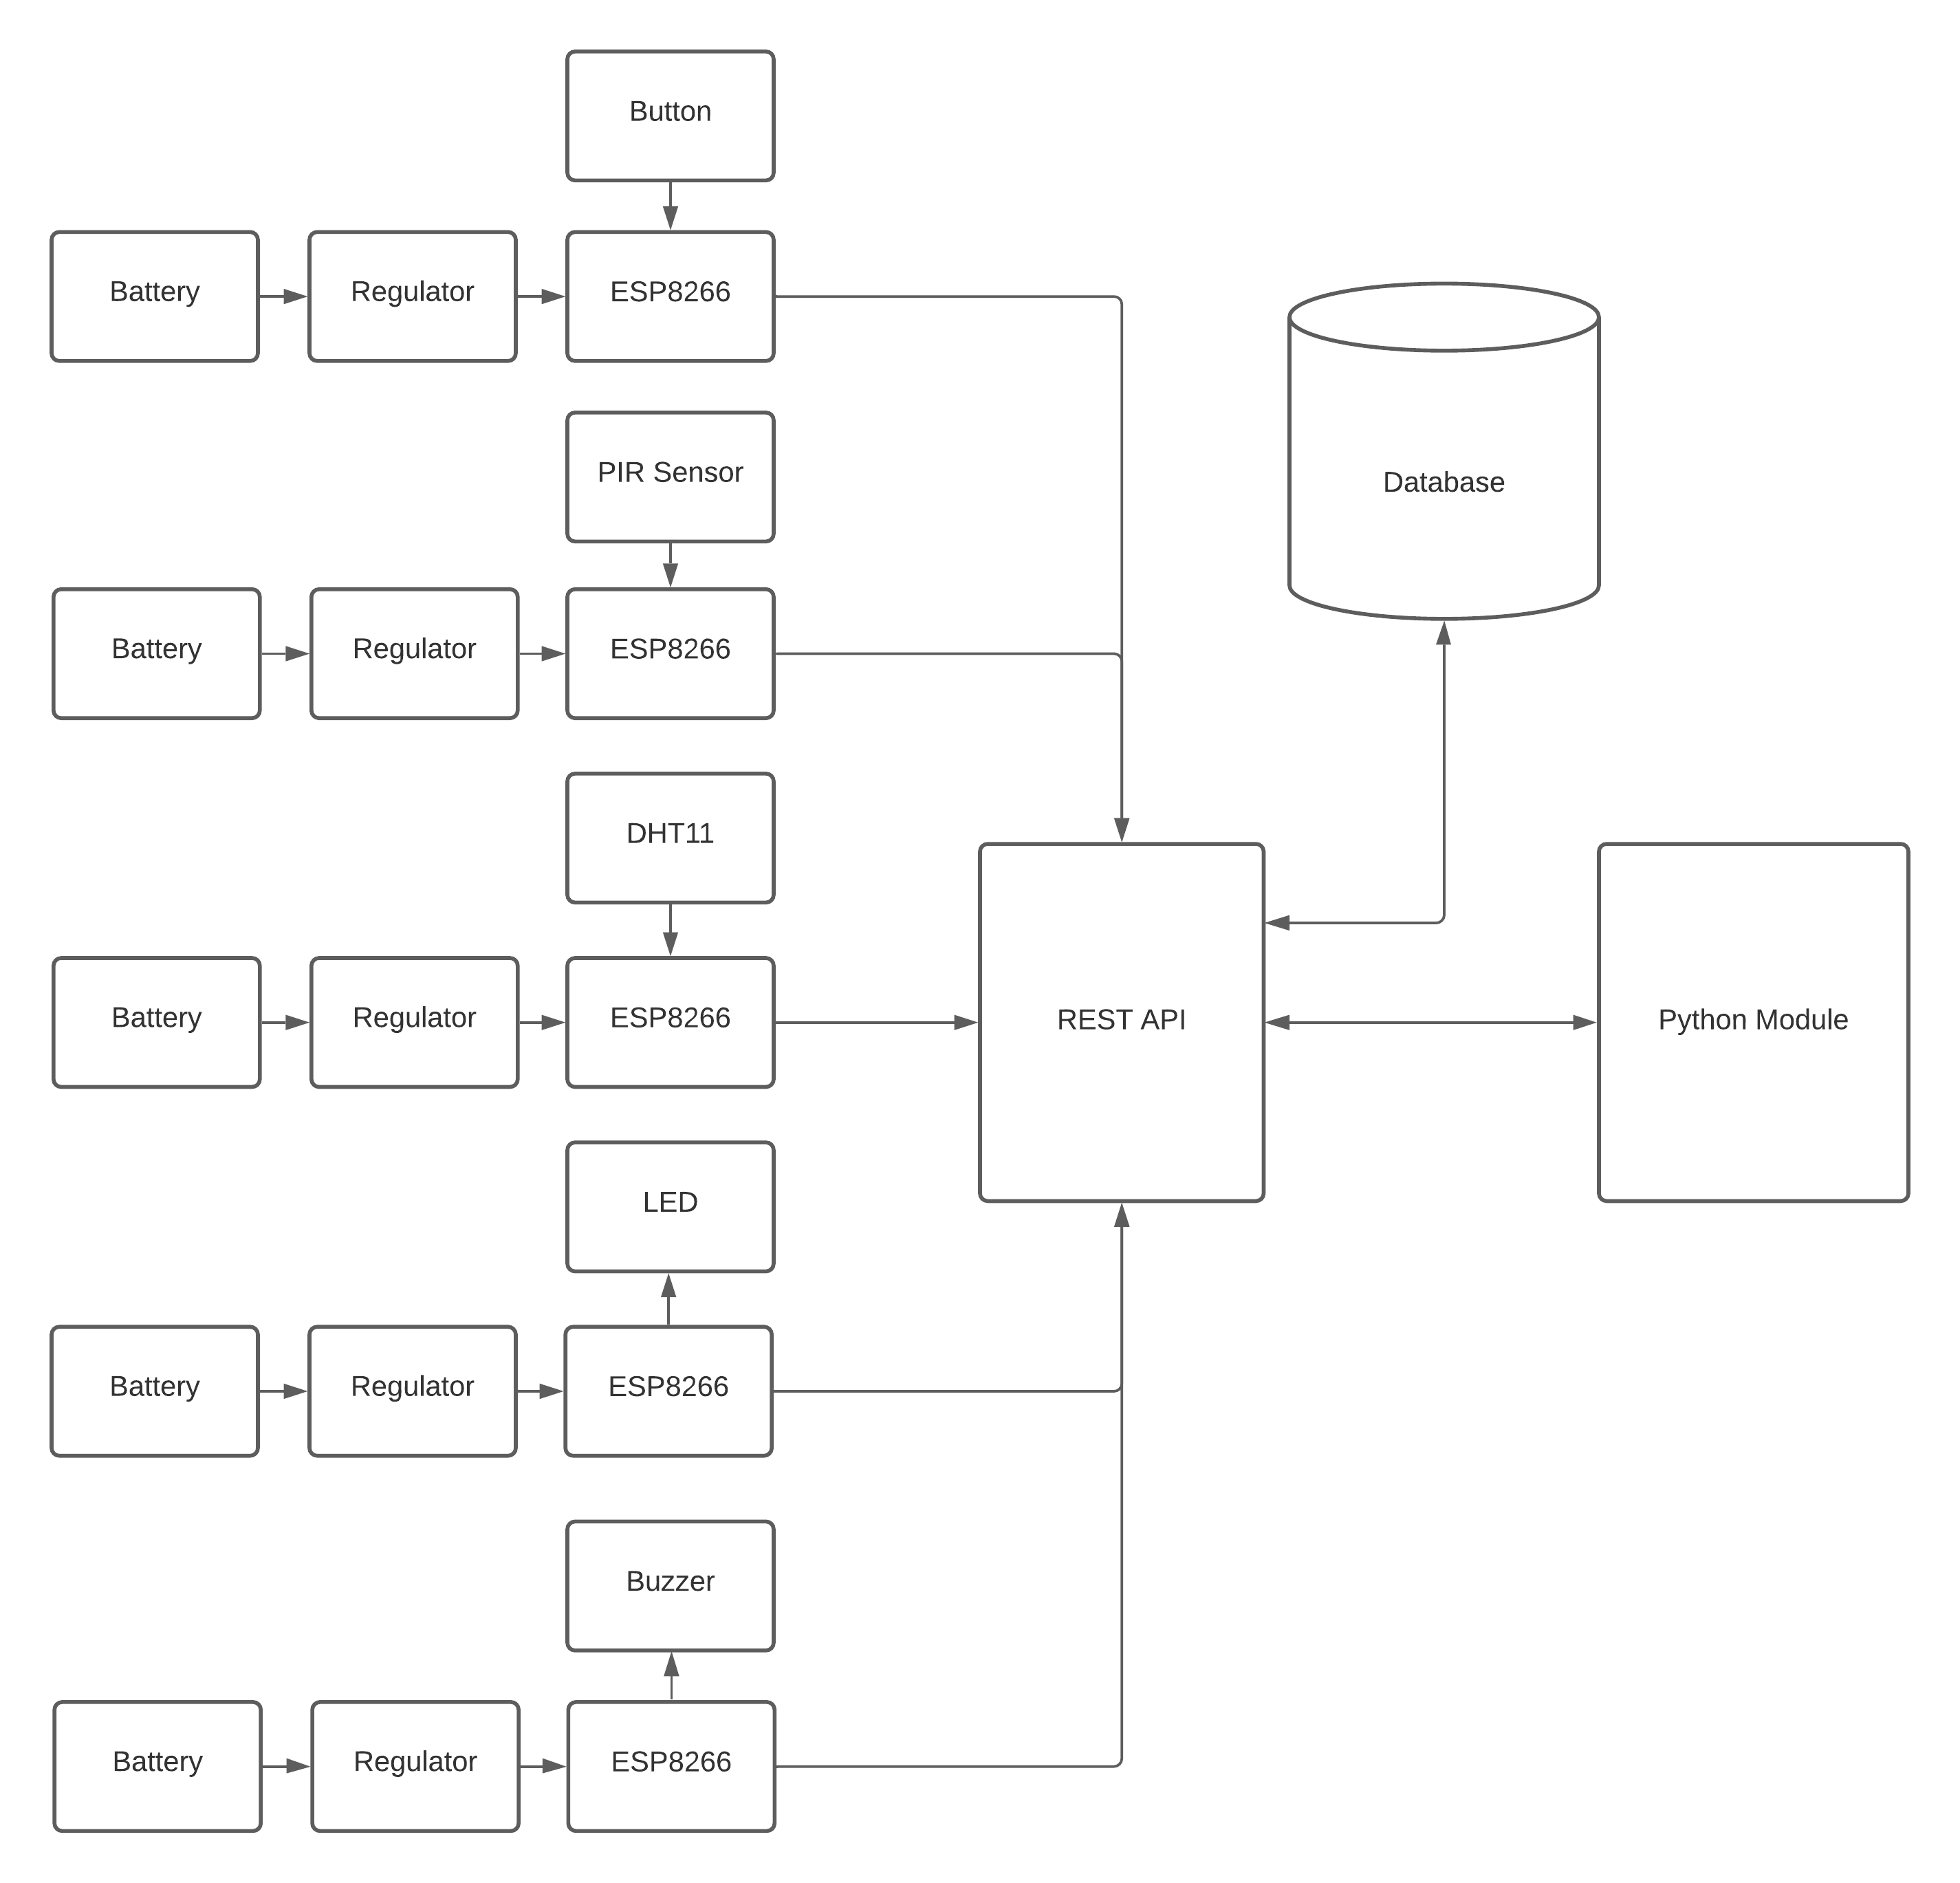
14
Block Diagram
Block 01
Block 02
Block 03
Block 04
Block N
IOT REAL WORLD PROGRAMMBLE BLOCKS

Slide 15
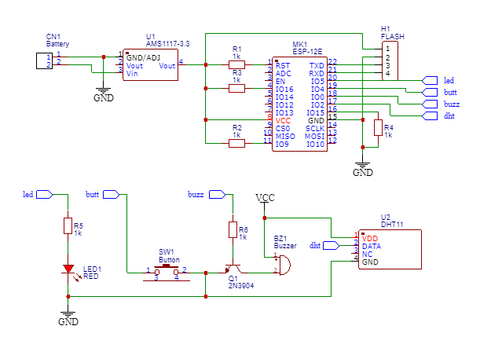
15
Circuit Diagram
IOT REAL WORLD PROGRAMMBLE BLOCKS

Slide 16
16
E-R Diagram
email
password
D_id
Action
id
name
user
device
name
U_id
value
action
u_id
timestamp
d_id
IOT REAL WORLD PROGRAMMBLE BLOCKS

Slide 17
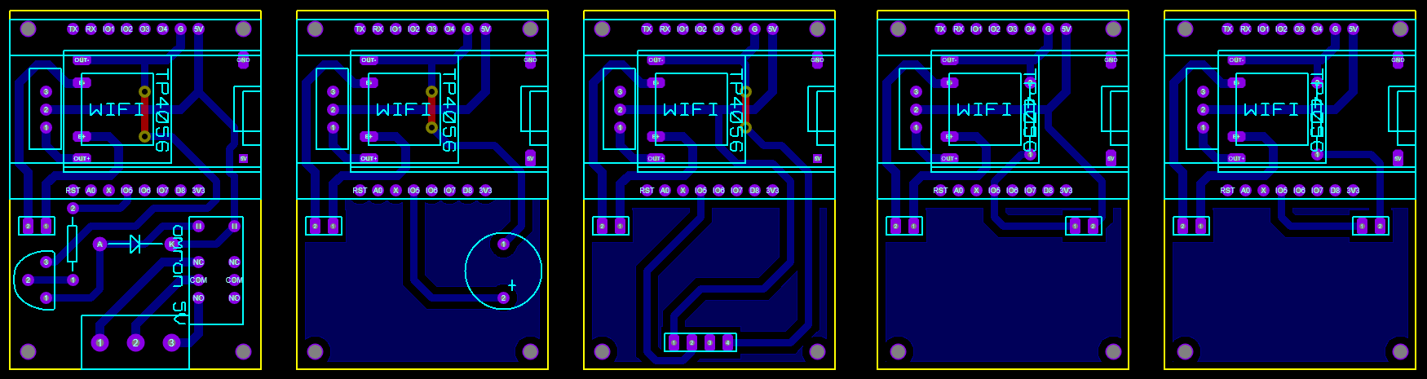
17
PCB Design
IOT REAL WORLD PROGRAMMBLE BLOCKS

Slide 18
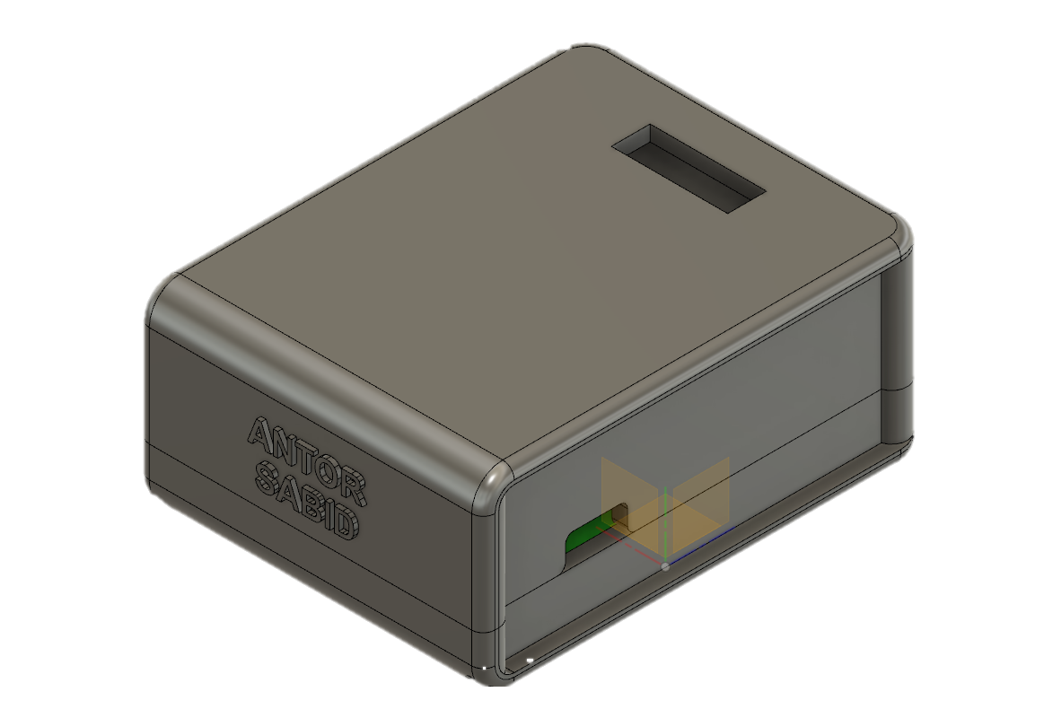
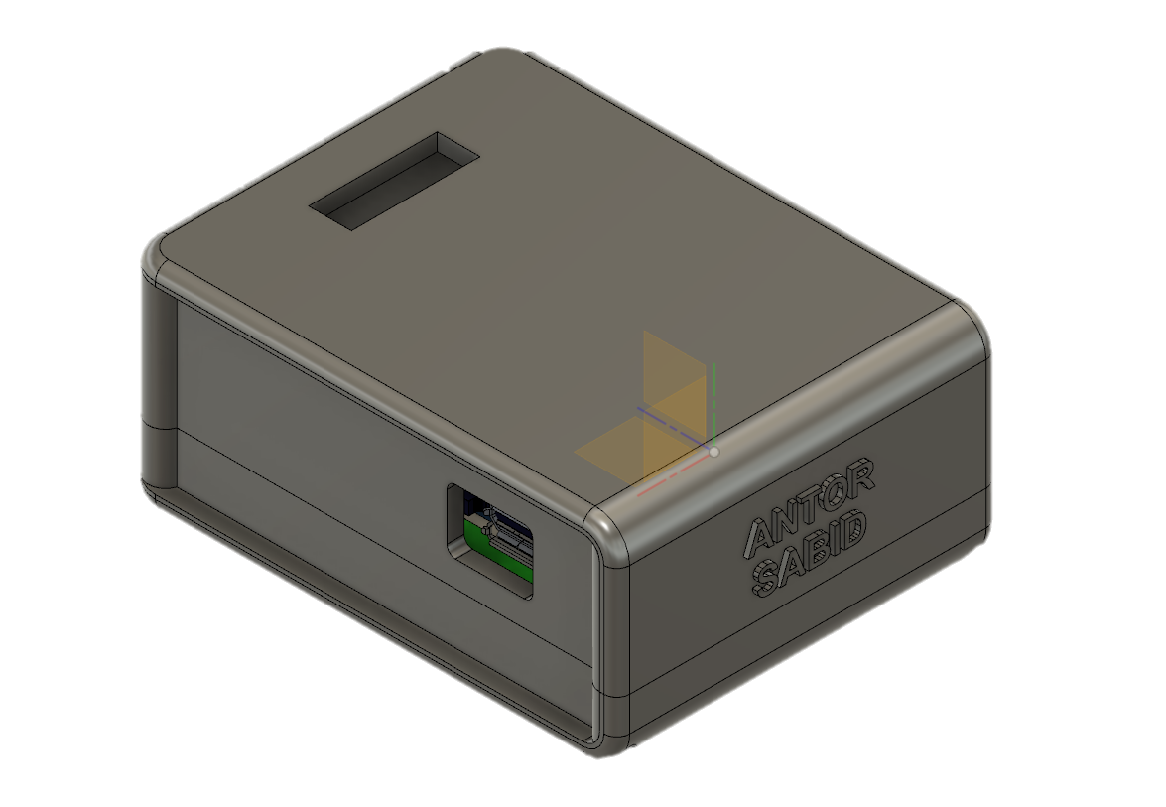
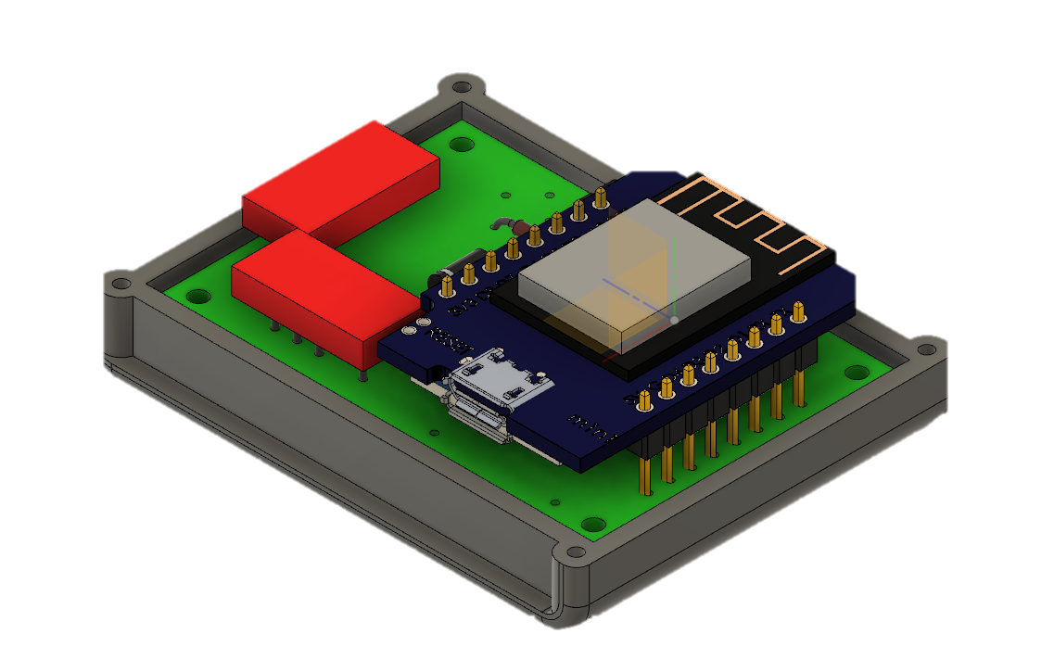
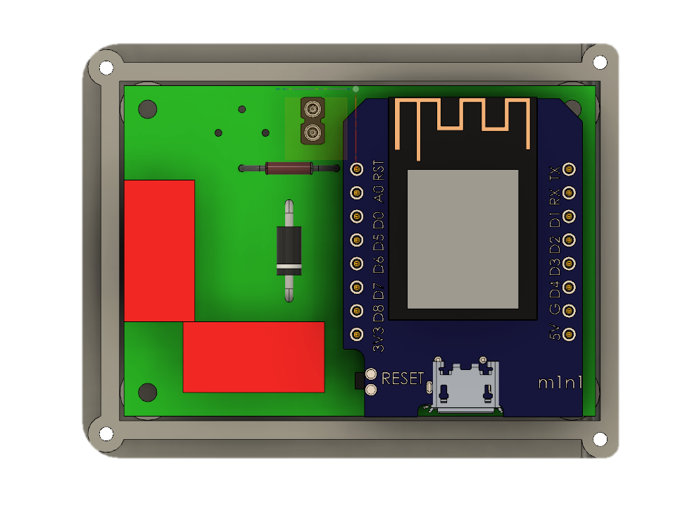
18
3D Design
IOT REAL WORLD PROGRAMMBLE BLOCKS

Slide 19
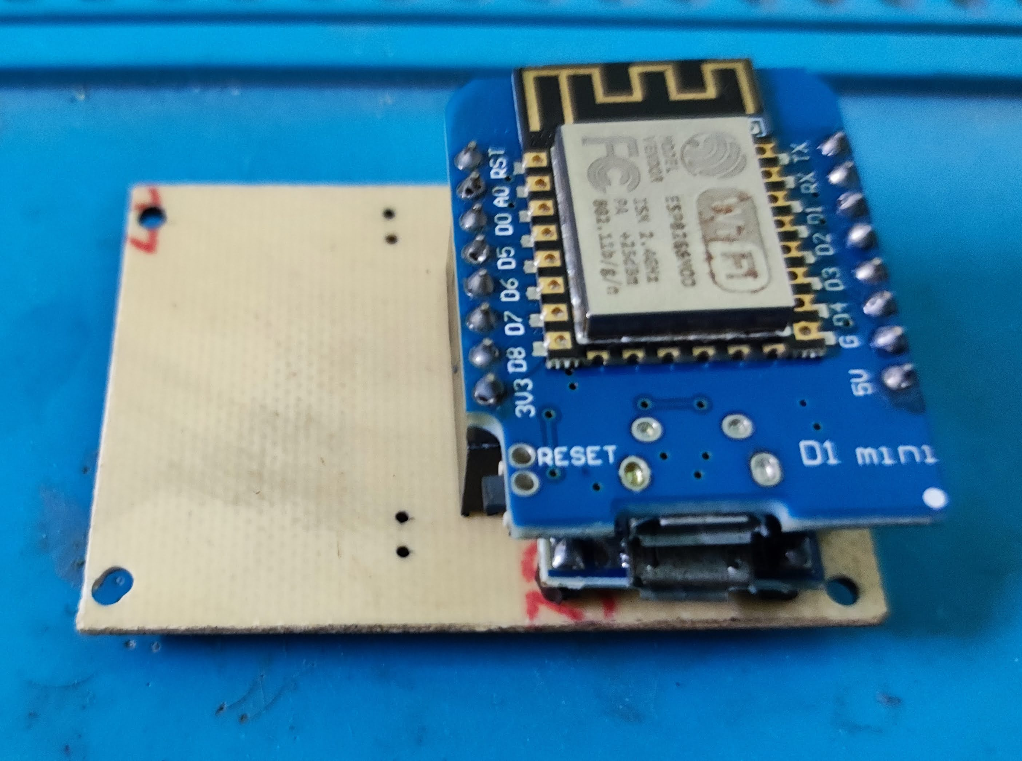
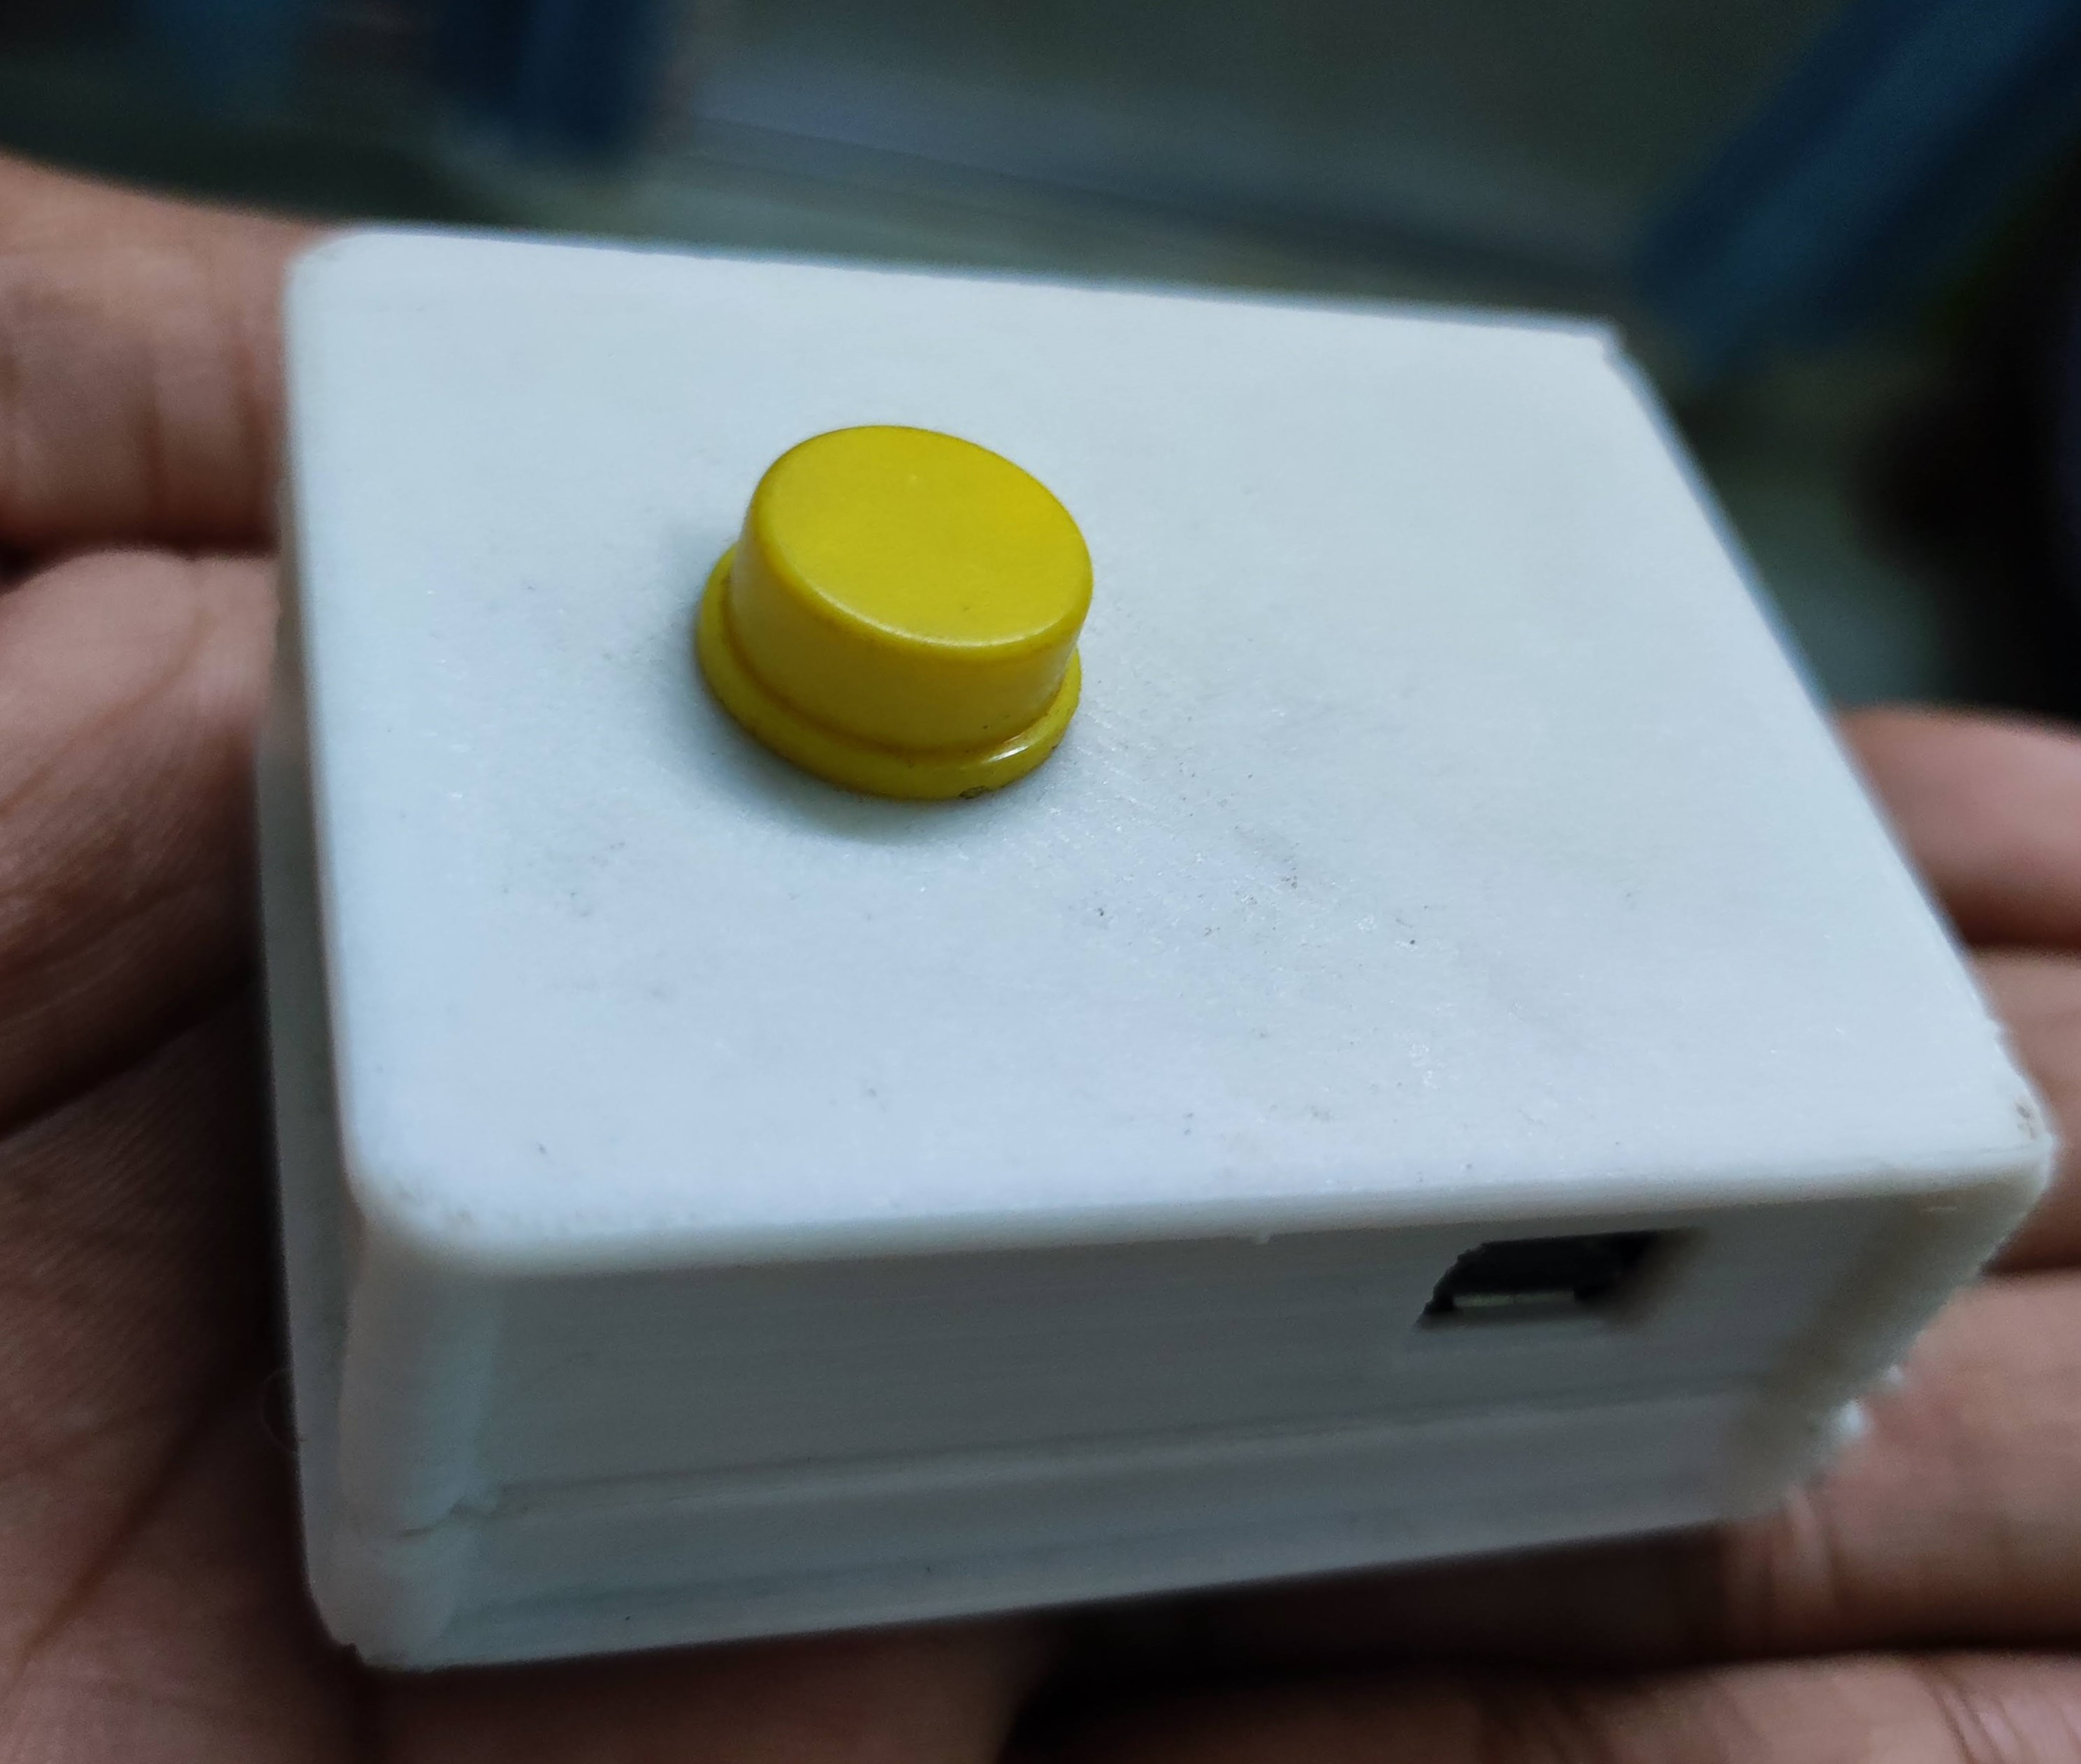
19
Implementation – 1/5
Inside View
Button Block Circuit
Outside View
IOT REAL WORLD PROGRAMMBLE BLOCKS

Slide 20
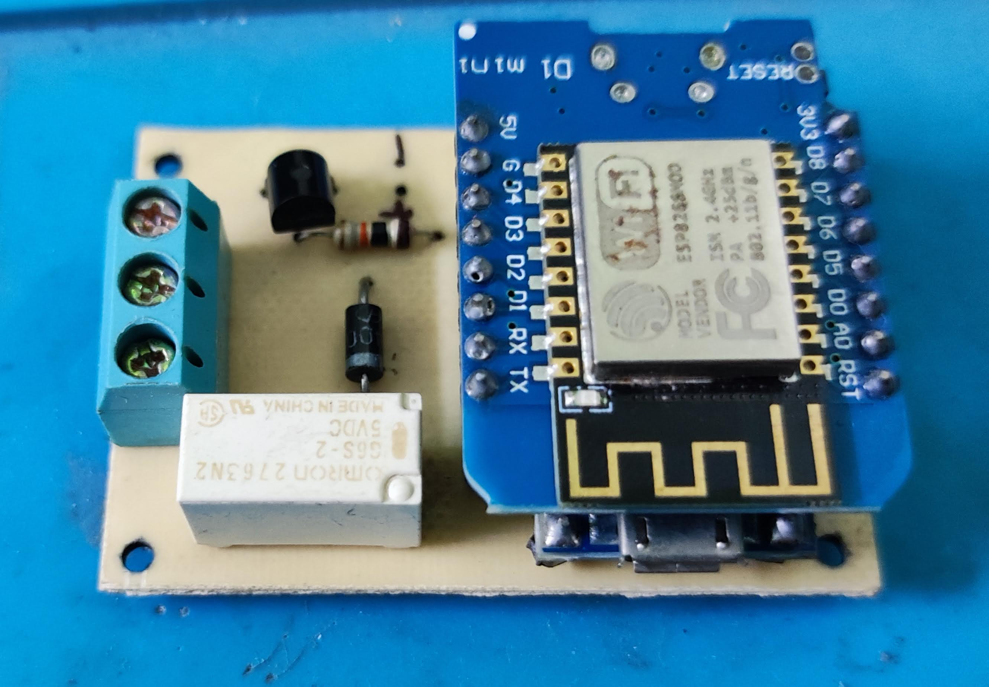
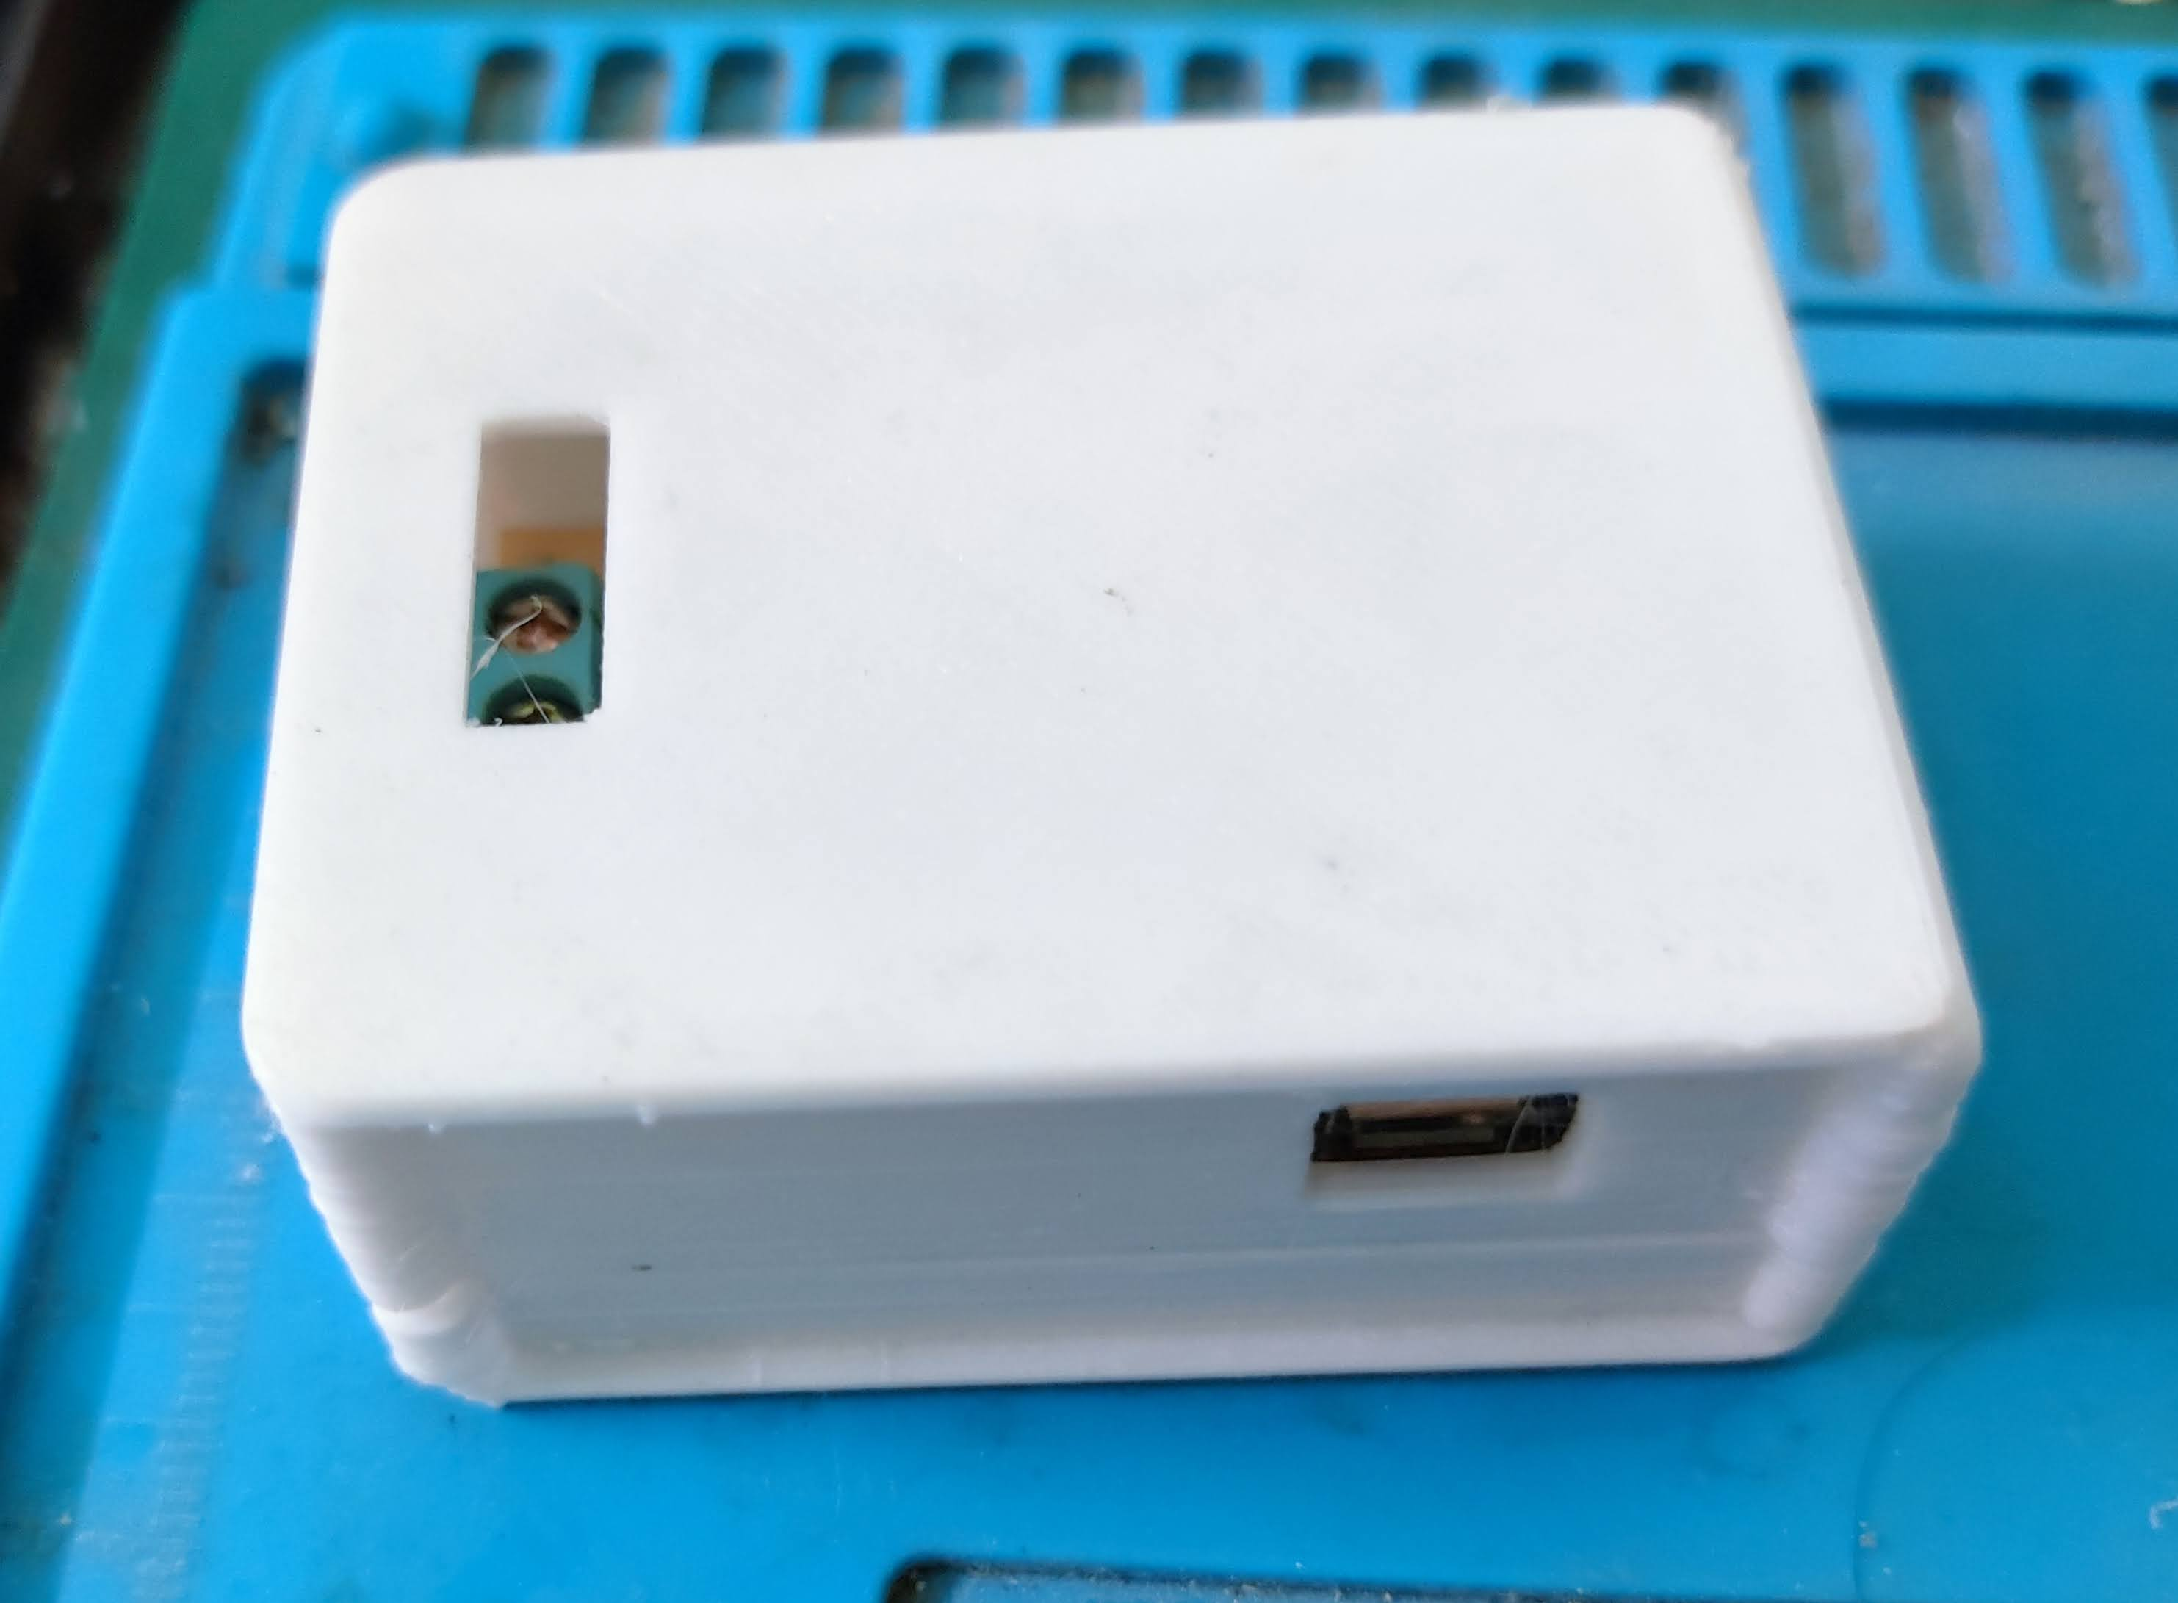
20
Implementation – 2/5
Inside View
Relay Block Circuit
Outside View
IOT REAL WORLD PROGRAMMBLE BLOCKS

Slide 21
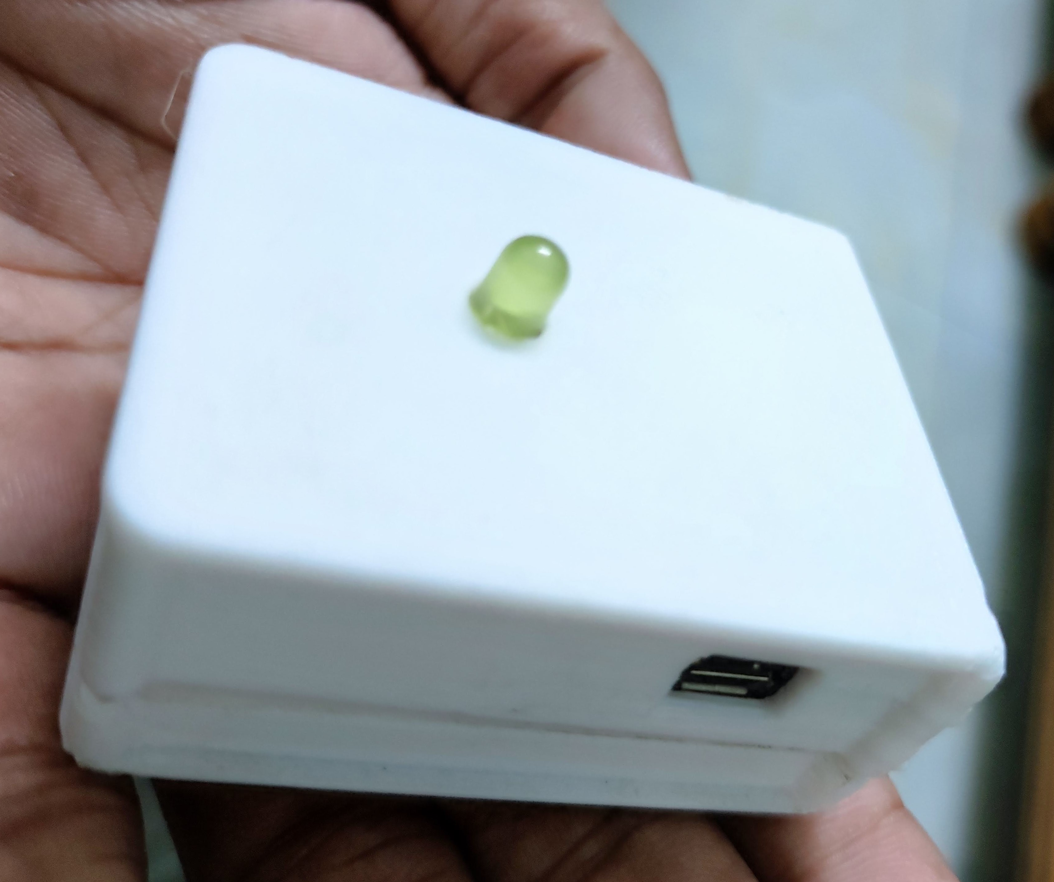
21
Implementation – 3/5
Inside View
LED Block Circuit
Outside View
IOT REAL WORLD PROGRAMMBLE BLOCKS

Slide 22
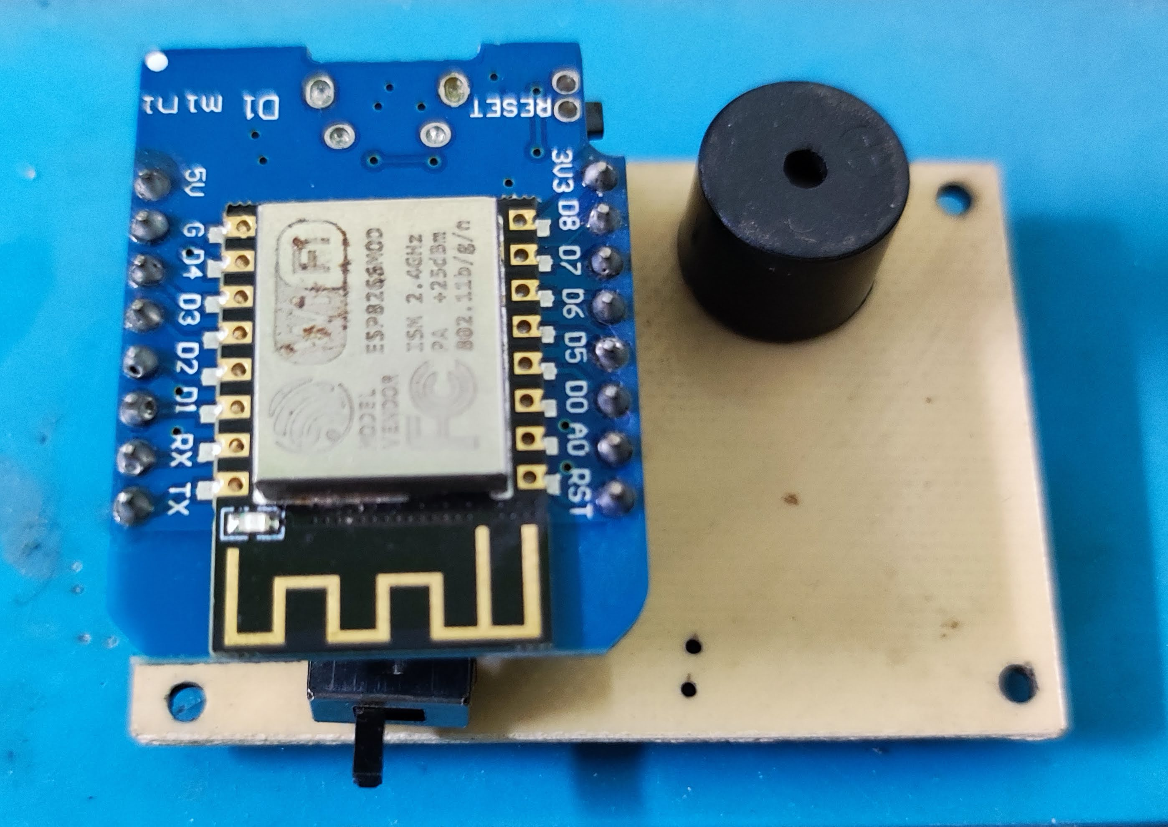
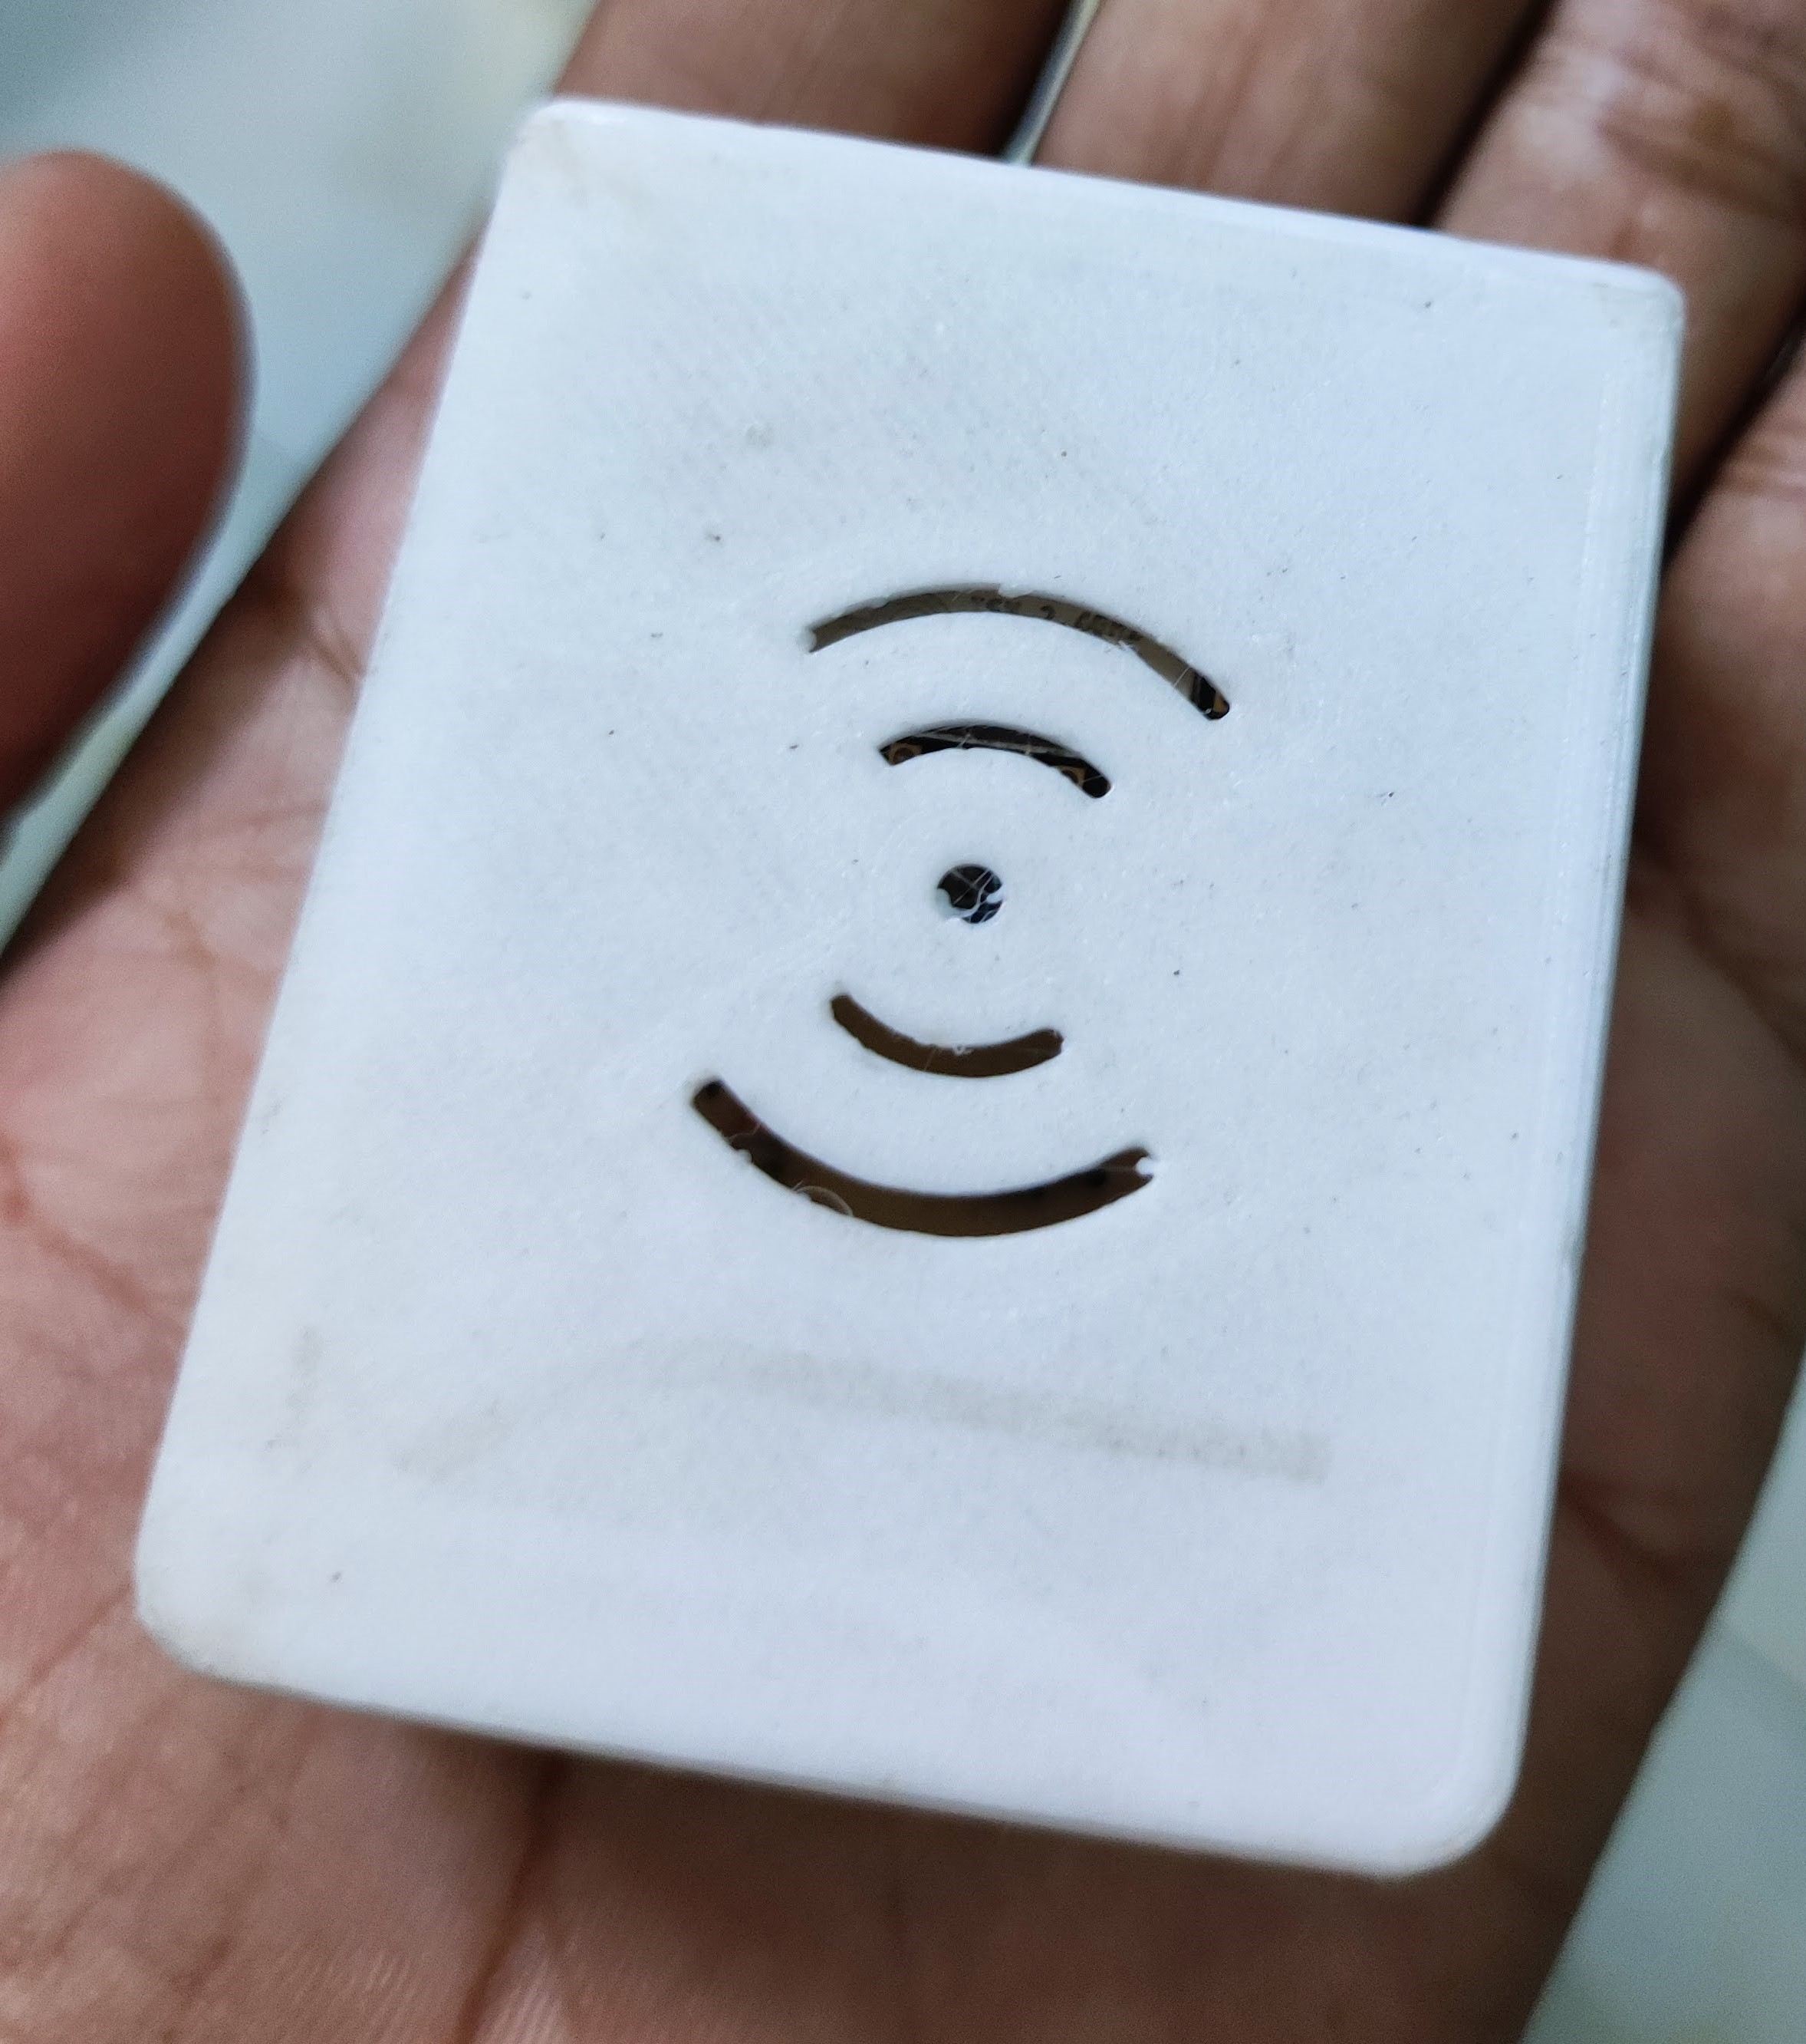
22
Implementation – 4/5
Inside View
Buzzer Block Circuit
Outside View
IOT REAL WORLD PROGRAMMBLE BLOCKS

Slide 23
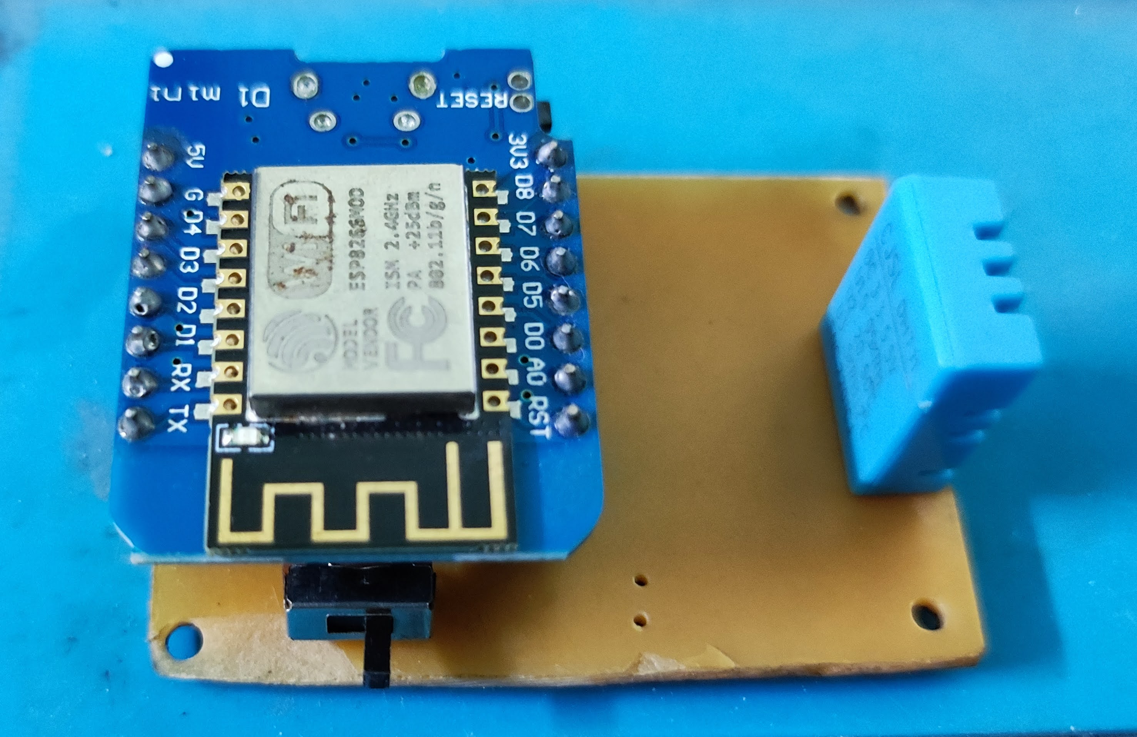
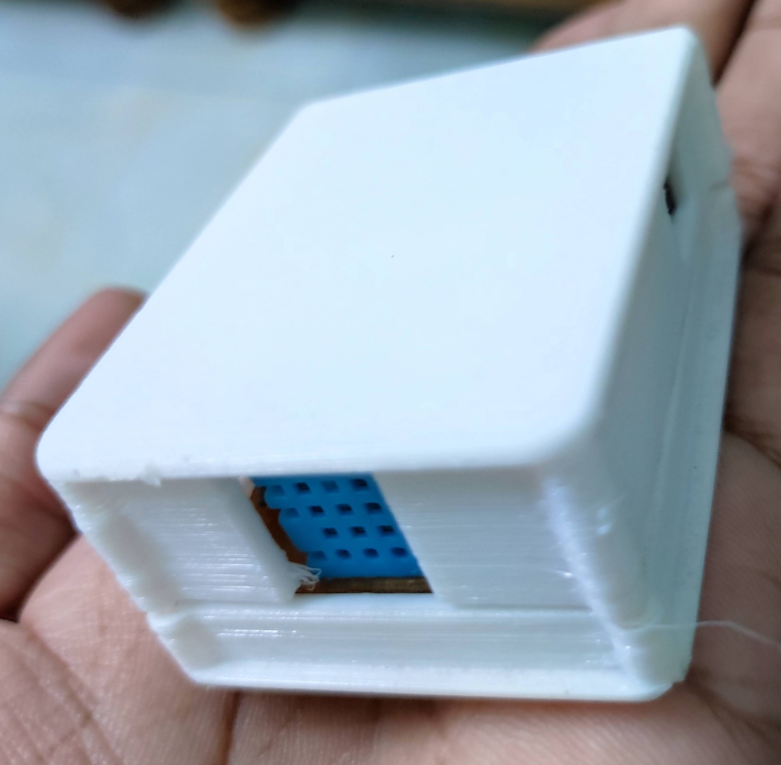
23
Implementation – 5/5
Inside View
Temp. Block Circuit
Outside View
IOT REAL WORLD PROGRAMMBLE BLOCKS

Slide 24
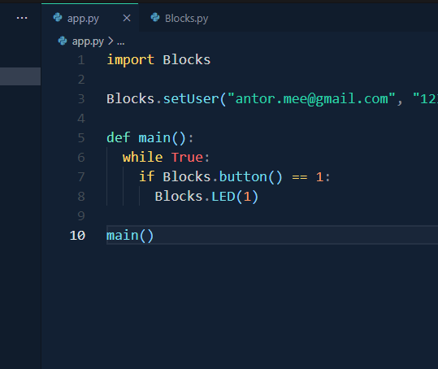
24
Sample Script
Super easy to apply any kind of logic!
JUST LIKE:
IF HAPPENED THIS,
THEN DO THAT
IOT REAL WORLD PROGRAMMBLE BLOCKS

Slide 25
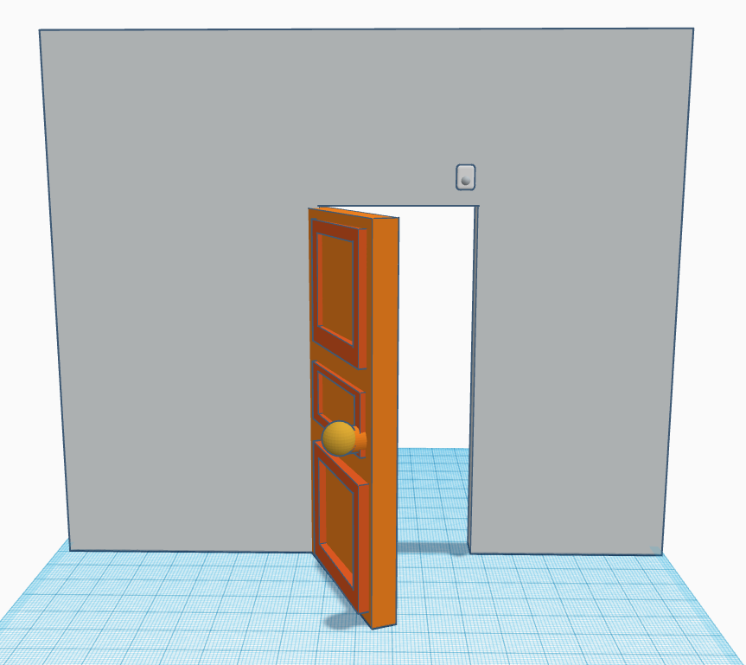
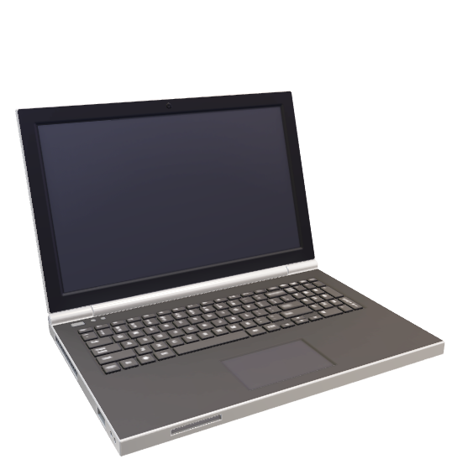
25
Application – 1/2
Motion Block
Turn on the room light when someone enter to the room also send me a mail.
IOT REAL WORLD PROGRAMMBLE BLOCKS

Slide 26
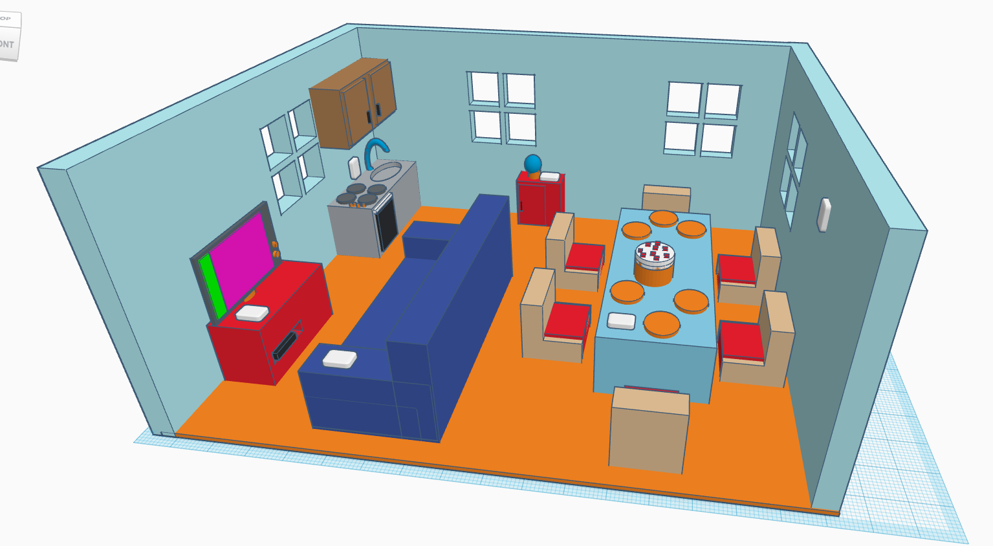
26
Application – 2/2
LED Block
Fire Block
Beep when Fire or temp. is >32, turn on LED. If button pressed toggle TV, if fire also send me mail.
Relay
Block
Temp. Block
Buzzer Block
Button Block
IOT REAL WORLD PROGRAMMBLE BLOCKS

Slide 27
Future Works
27
A.I can be added so far device can recognize human pattern for controlling any blocks.
Raspberry Pi can be use for portable central CPU.
Security for authentication can be improve.
Device data logger can be added.
Anti-hack security like brute force attack should be prevent.
Graphical User Interface for logical expression.
IOT REAL WORLD PROGRAMMBLE BLOCKS

Slide 28
Conclusion
28
These IoT-based blocks are just a few examples of how IoT technology can be used and implemented to create innovative products. With further advancements in technology, it is highly likely that more such radical and groundbreaking IoT-based projects will enter the canvas of our everyday lives. IoT is an integral part of our daily lives now; we all use IoT either knowingly or unknowingly.
IOT REAL WORLD PROGRAMMBLE BLOCKS

Slide 29
THANK YOU!
29
IOT REAL WORLD PROGRAMMBLE BLOCKS

